Slide 1

On the Relation between Software 2.0 and Gödel’s Incompleteness Theorems
Nate
natitaw.com

Slide 2
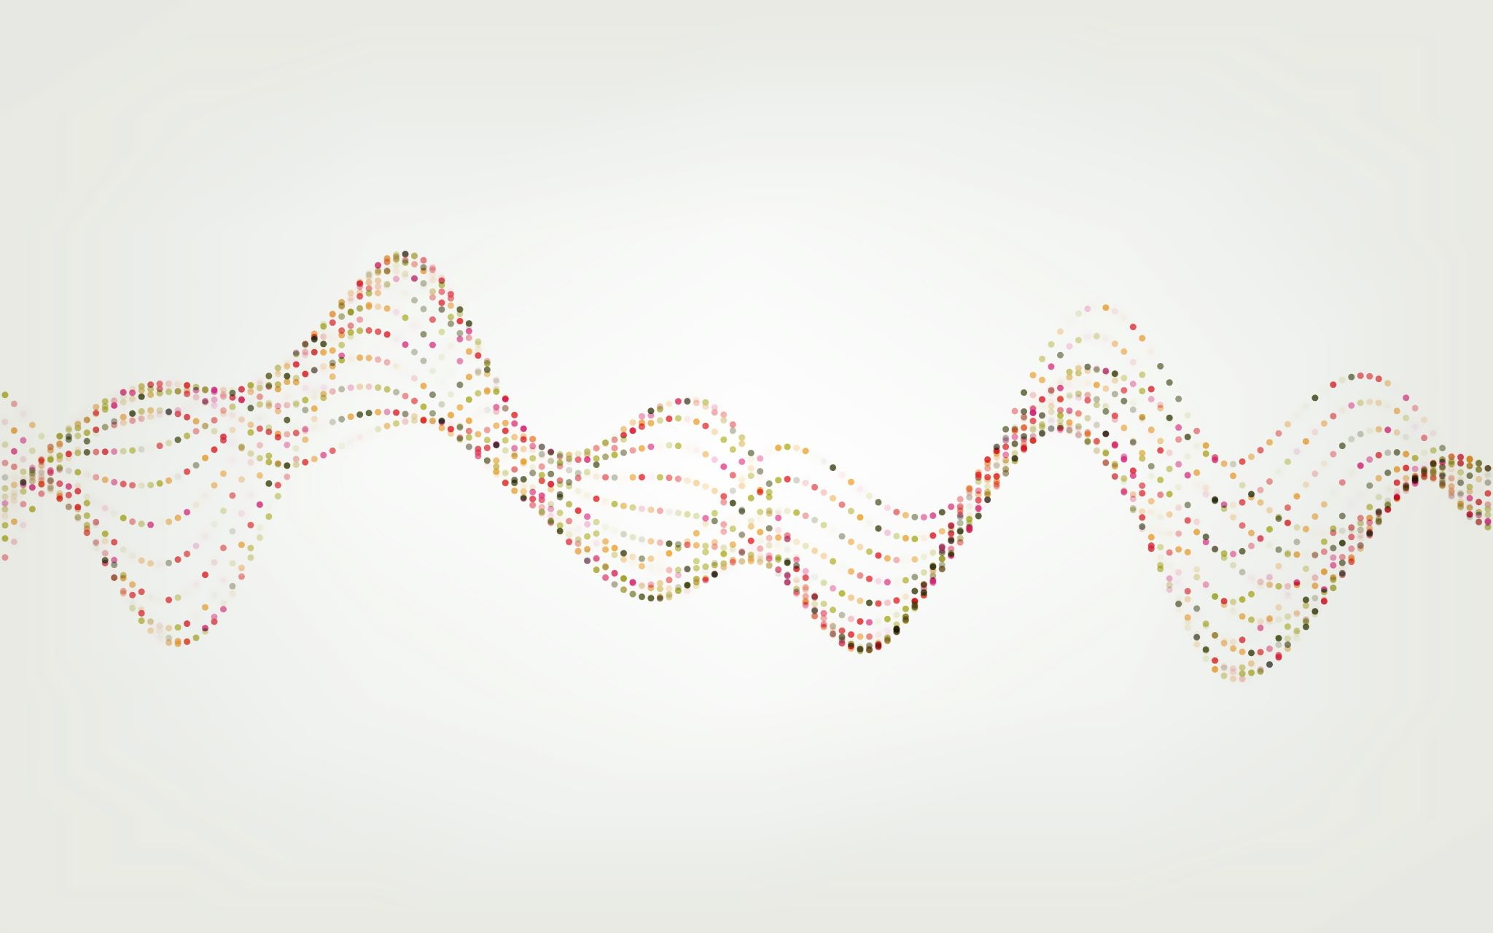
How do we encode information into a computer?

Slide 3
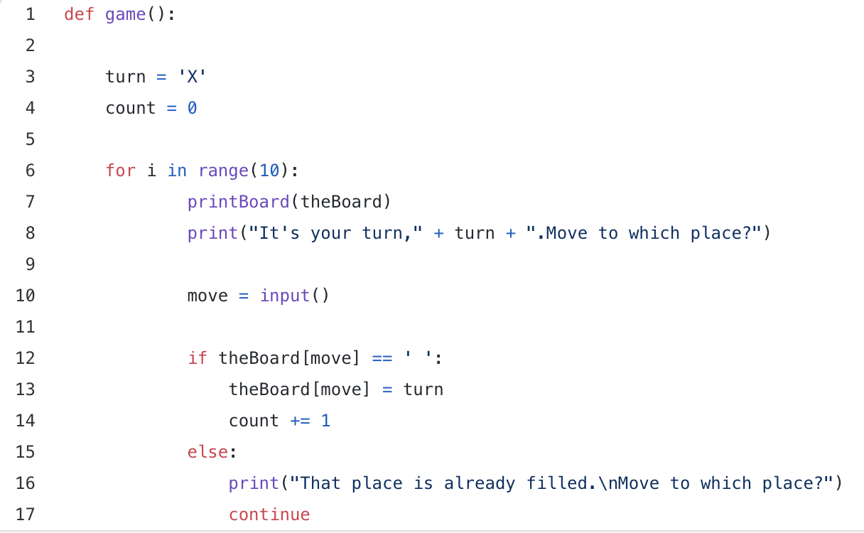
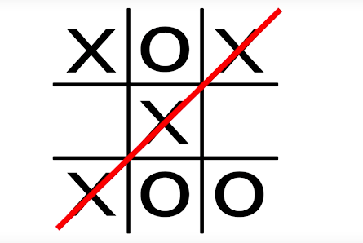
A Simple Case – Tic-Tac Toe
Define Game Boundary
Define Rules
Execute a Search Algorithm

Slide 4
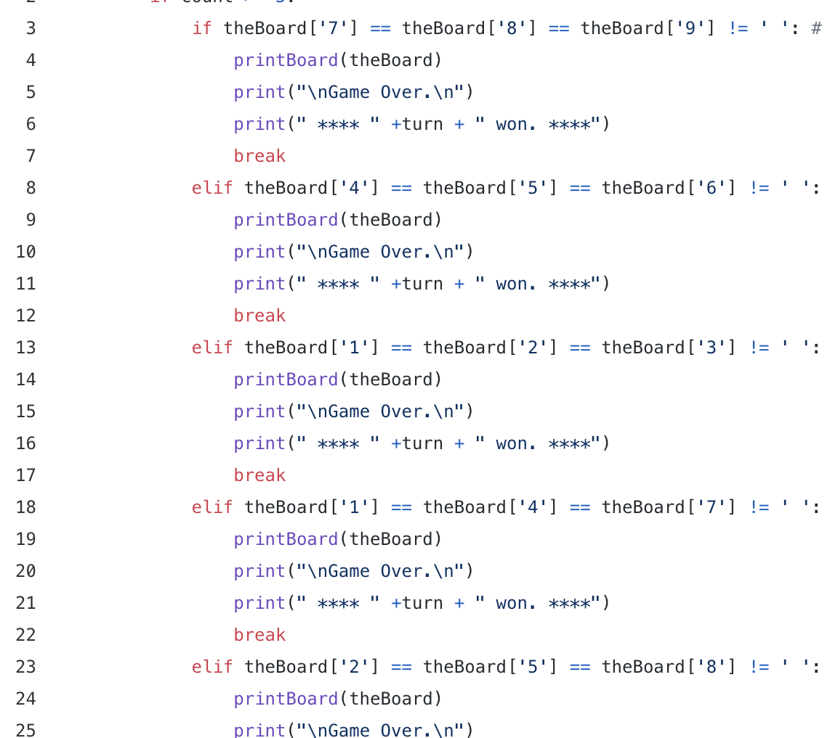
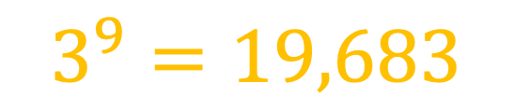
A Simple Case – Tic-Tac Toe
Force Compute
$$3^{9}=19,683$$

Slide 5
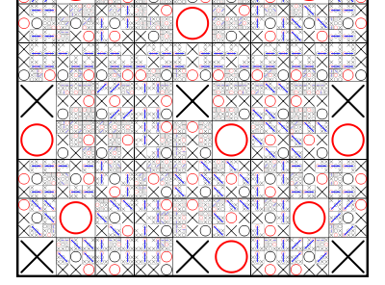
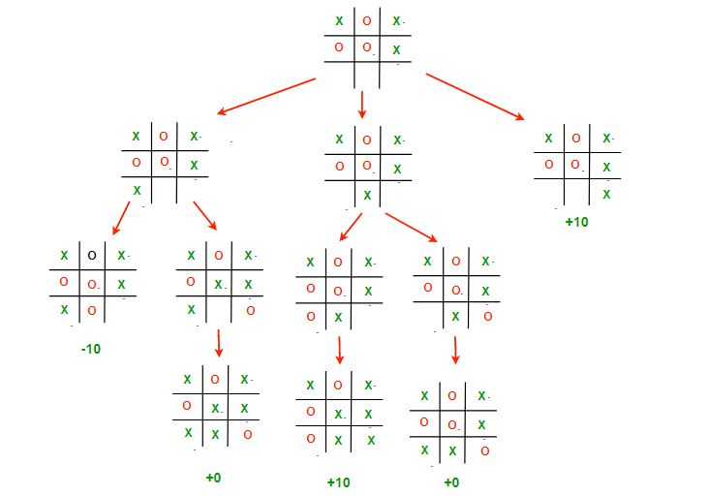
Software 1.0 ✅
Tic-Tac Toe

Slide 6
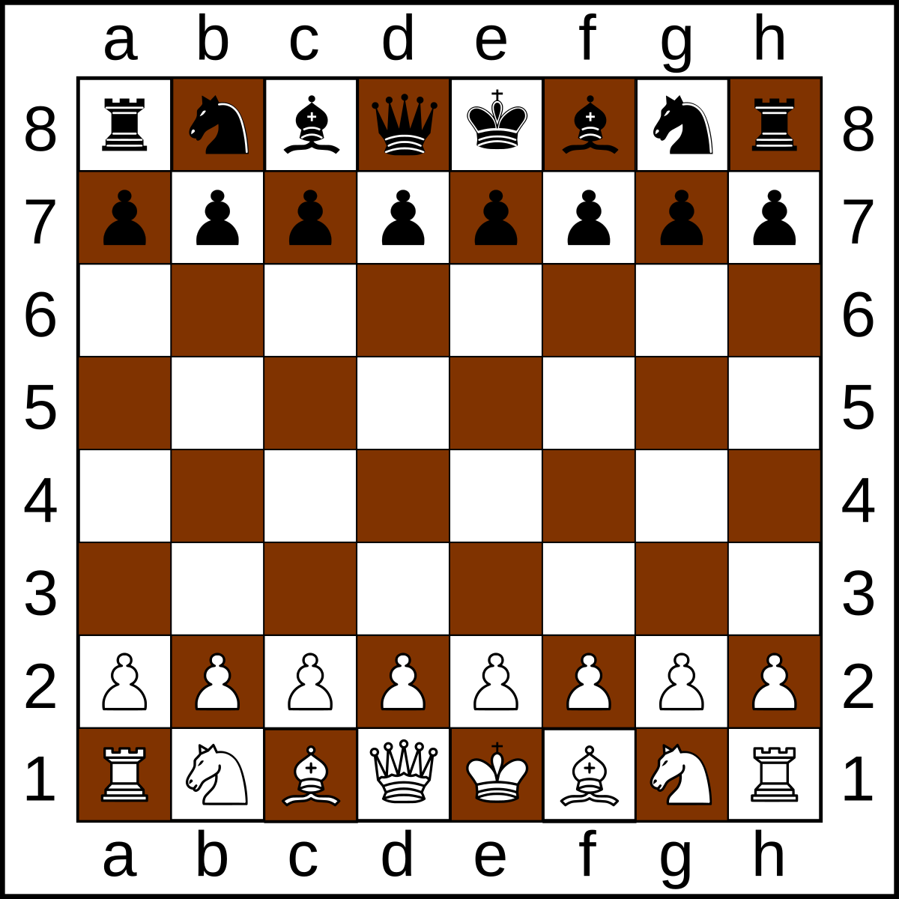
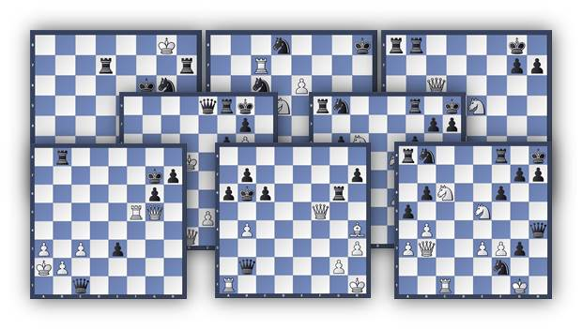
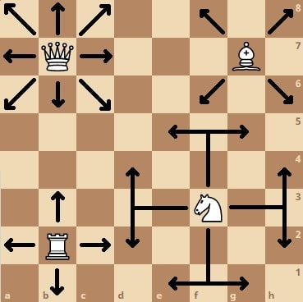
Slight Complication -- Chess
Define Rules
Execute a Search Algorithm

Slide 7
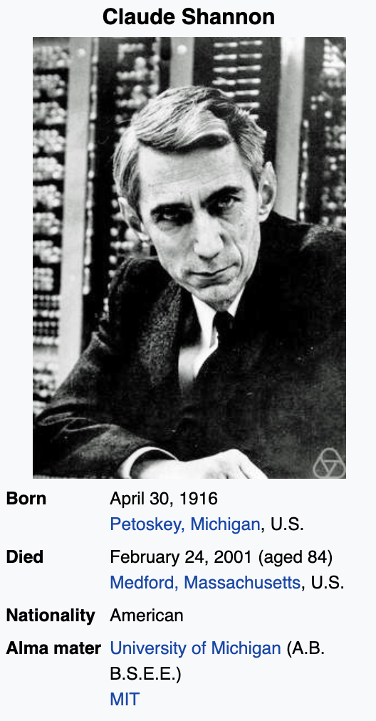
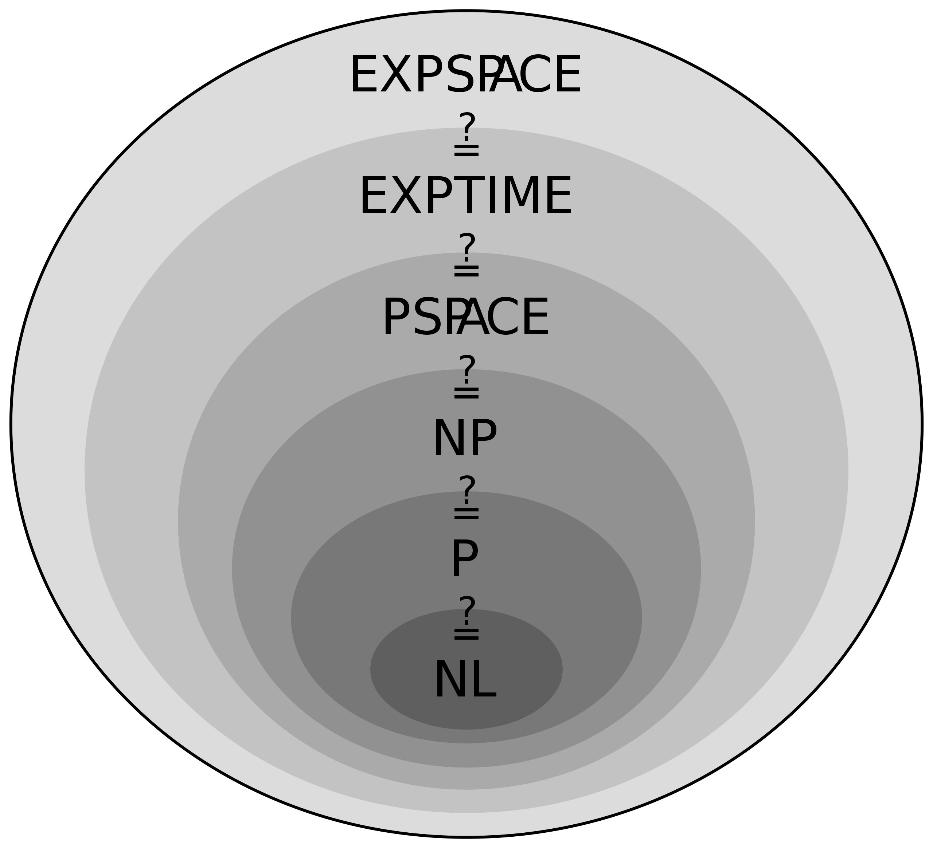
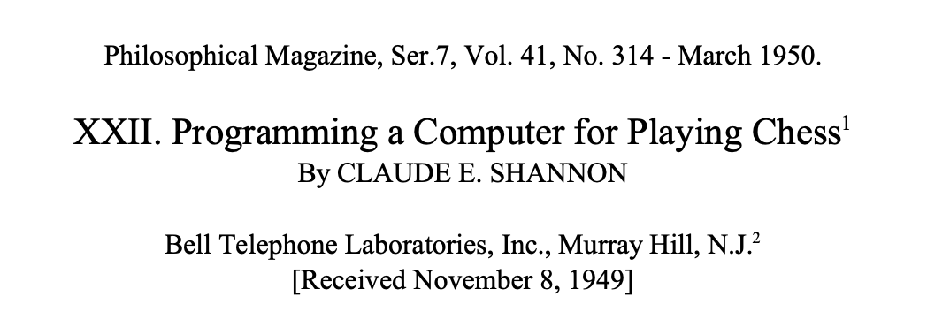
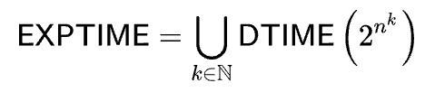
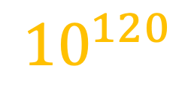
Game-Tree Complexity of Chess
Possible States of Chess
$${10}^{120}$$

Slide 8
Enter Software 2.0

Slide 9
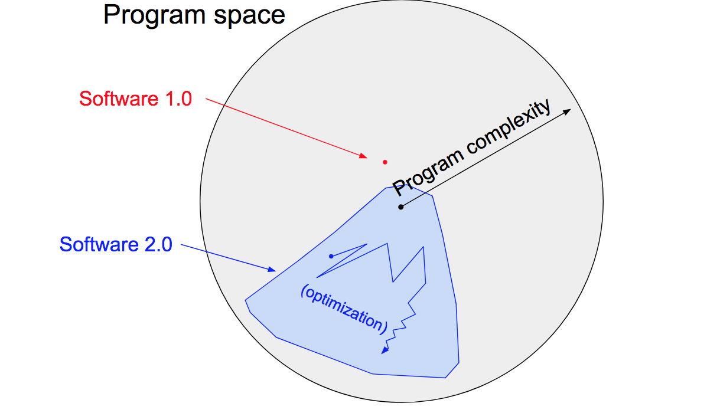
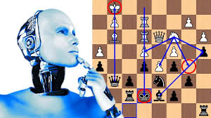
What is Software 2.0?

Slide 10

Abstraction
When you go on a higher level abstraction, you can fit in more things in your head. You can think more.
— Christ Lantner (Creator of the LLVM)

Slide 11
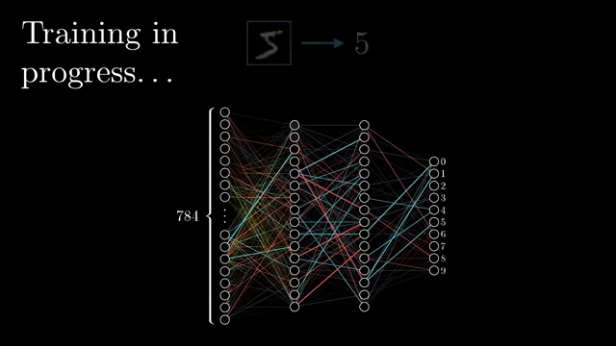
Modern Artificial Intelligence
Execute Training Cycles
Extract Rules from Data

Slide 12
What is Meaning?

Slide 13
In the past, your source code is your code. In the future, your source code is your data.

Slide 15
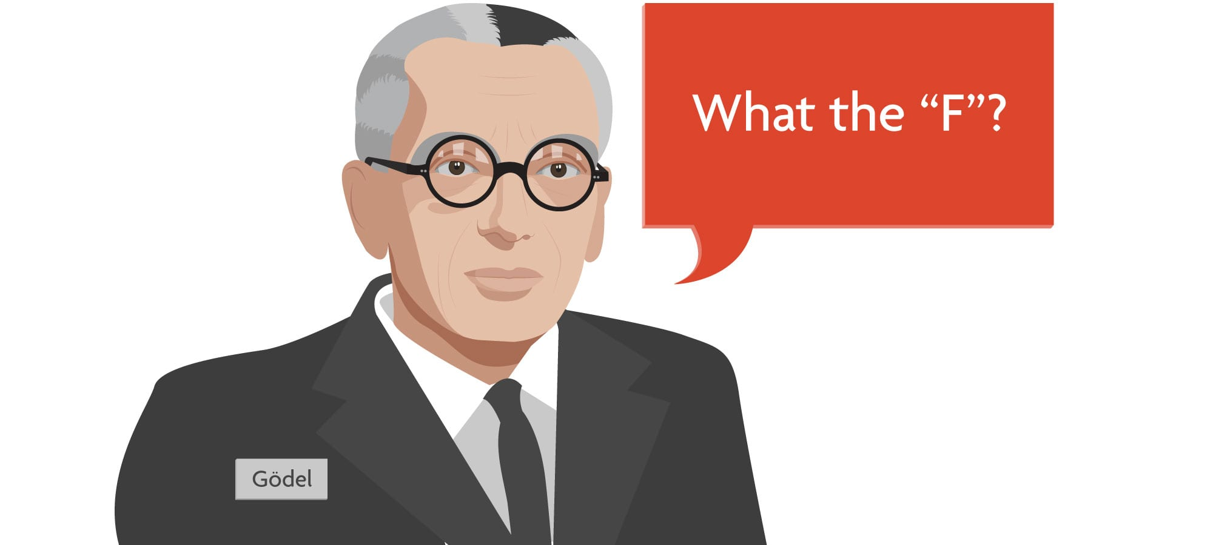
Incompleteness

